Slide 1
Electronic Devices and Circuits Lecture-3
CSE 223
Prepared by
Ipshita Tasnim Raha
Lecturer (Provisional)
Dept. of CSE
Varendra University

Slide 2


Slide 3
Zener Diode

Slide 4
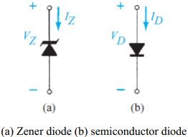
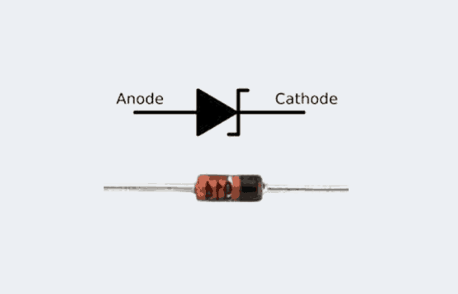
Zener Diode:
A zener diode is a special type diode designed to operate in the reverse breakdown region.
Usually, it is heavily doped to reduce the reverse breakdown voltage. In the zener breakdown region, the diode maintains a constant voltage regardless of the value of current through the device. This permits the zener diode to be used as a voltage regulator.
The symbol, conduction direction of two types of diode is given below,
Prepared by Ipshita Tasnim Raha

Slide 5
Characteristics & Working Principle
Visual representation is always helpful
Link: https://www.youtube.com/watch?v=bN6_eHJQKz4
Prepared by Ipshita Tasnim Raha

Slide 6
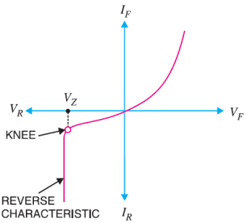
Zener Diode
The characteristics of zener diode is given below
A zener diode is like an ordinary diode except that it is properly doped so as to have a sharp breakdown voltage.
A zener diode is always reverse connected that is, it is always reverse biased.
A zener diode has sharp breakdown voltage, called zener voltage V_{Z}.
When forward biased, its characteristics are just those of ordinary diode.
The zener diode is not immediately burnt just because it has entered the breakdown region. As long as the external circuit connected to the diode limits the diode current to less than burn out value, the diode will not burn out.
Fig: Characteristics of Zener Diode
Prepared by Ipshita Tasnim Raha

Slide 7
Zener Diode
Review Zener Diode Visually
Link: https://www.youtube.com/watch?v=V5nWu8EbMhI
Prepared by Ipshita Tasnim Raha

Slide 8
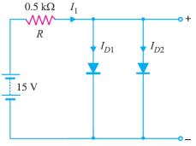
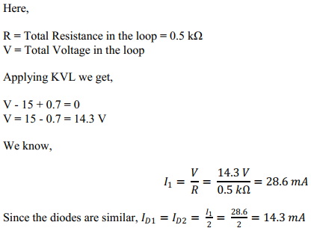
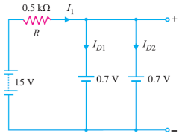
Example Problems of Diode
Example 1: Determine current through each diode in the circuit. Assume both diode are similar and made of silicon.
Solution: As the diodes both are made of silicon and both are in forward bias, the voltage across it will be 0.7 V. So we can redraw it as,
Prepared by Ipshita Tasnim Raha

Slide 9
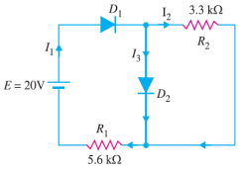
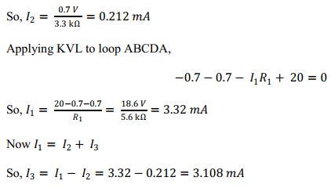
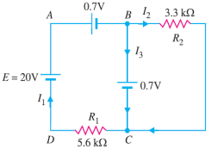
Example Problems of Diode
Example 2: Determine the currents I1, I2 and I3 for the network. Assume both diode are similar
and made of silicon.
Solution: As the diodes both are made of silicon and both are in forward bias, the voltage across it will be 0.7 V. So we can redraw the circuit as,
The voltage across R2 is 0.7 V. Here, R2 = 3.3 kΩ
Prepared by Ipshita Tasnim Raha

Slide 10
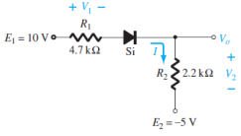
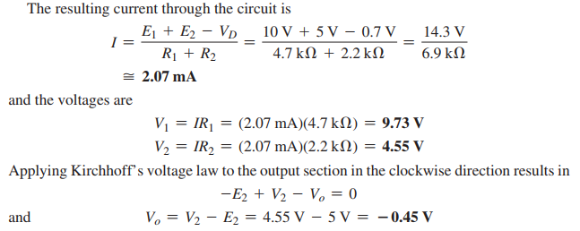
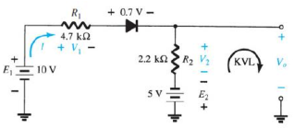
Example Problems of Diode
Example 3: Determine I , V1 , V2 , and Vo for the following circuit
Solution: As the Diode is made of Si and it is in ON state we get the circuit,
Prepared by Ipshita Tasnim Raha

Slide 11
Types of Diodes and Their Uses

Slide 12
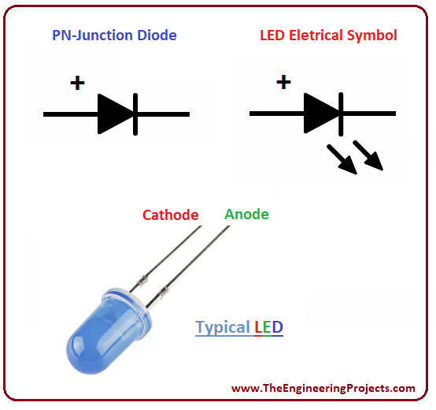

Light Emitting Diode (LED)
LED (Light Emitting Diode) is basically a small light emitting device that comes under “active” semiconductor electronic components. It’s quite comparable to the normal general purpose diode, with the only big difference being its capability to emit light in different colors. The two terminals (anode and cathode) of a LED when connected to a voltage source in the correct polarity, may produce lights of different colors, as per the semiconductor substance used inside it.
Prepared by Ipshita Tasnim Raha

Slide 13
LED Working Principle
A light-emitting diode is a two-lead semiconductor light source. It is a p–n junction diode that emits light when activated. When a suitable voltage is applied to the leads, electrons are able to recombine with electron holes within the device, releasing energy in the form of photons. This effect is called electroluminescence, and the color of the light (corresponding to the energy of the photon) is determined by the energy band gap of the semiconductor.
Prepared by Ipshita Tasnim Raha

Slide 14
LED Working Principle
Interested to know more?
Link: https://www.youtube.com/watch?v=4y7p9R2No-4
Prepared by Ipshita Tasnim Raha

Slide 15
Application
Advantages
1. Very low voltage and current are enough to drive the LED. (Voltage range – 1 to 2 volts. Current – 5 to 20 milliamperes.)
2. Total power output will be less than 150 milliwatts.
3. The response time is very less – only about 10 nanoseconds.
4. The device does not need any heating and warm up time.
5. Miniature in size and hence lightweight.
6. Have a rugged construction and hence can withstand shock and vibrations.
7. An LED has a lifespan of more than 20 years.
Disadvantages:
1. A slight excess of voltage or current can damage the device.
2. The device is known to have a much wider bandwidth compared to the laser.
3. The temperature depends on the radiant output power and wavelength.
Prepared by Ipshita Tasnim Raha

Slide 16
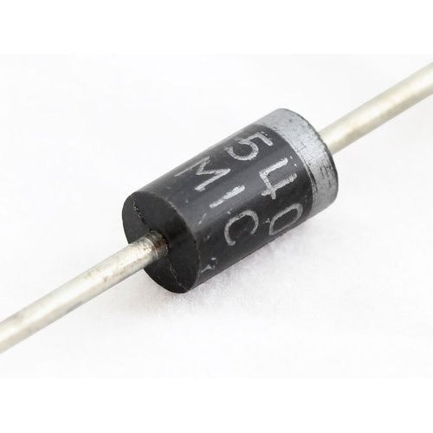
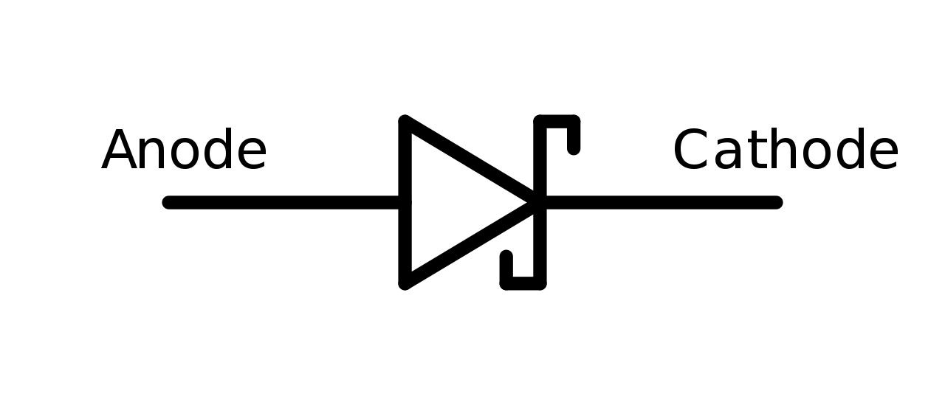
Schottky Diodes:
These diodes are designed to have a very fast switching time which makes them a great diode for digital circuit applications. They are very common in computers because of their ability to be switched on and off so quickly.
Learn more form: https://www.youtube.com/watch?v=nV3bBrQnws0
Prepared by Ipshita Tasnim Raha

Slide 17
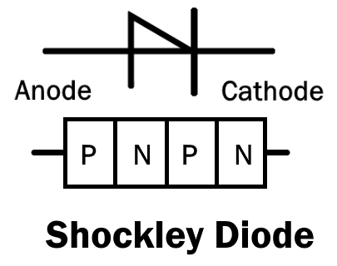
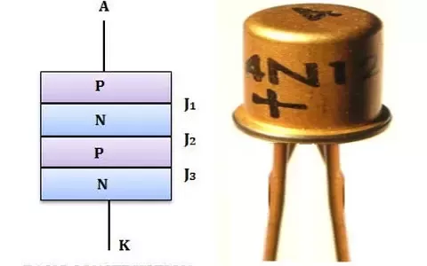
Shockley Diodes:
The Shockley diode is a four-layer diode while other diodes are normally made with only two layers. These types of diodes are generally used to control the average power delivered to a load.
Prepared by Ipshita Tasnim Raha

Slide 18
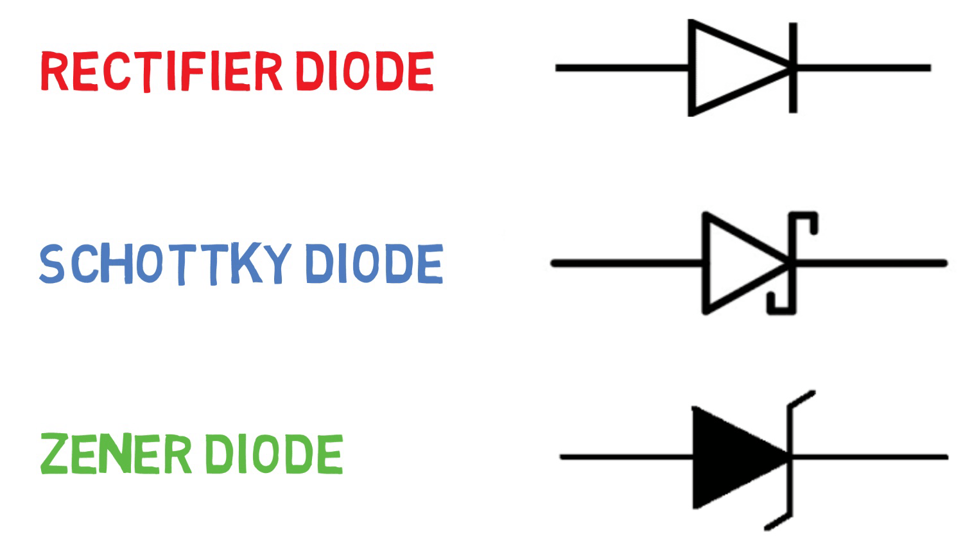
Difference Between:
Prepared by Ipshita Tasnim Raha

Slide 19
Diode Applications:
Rectification

Slide 20
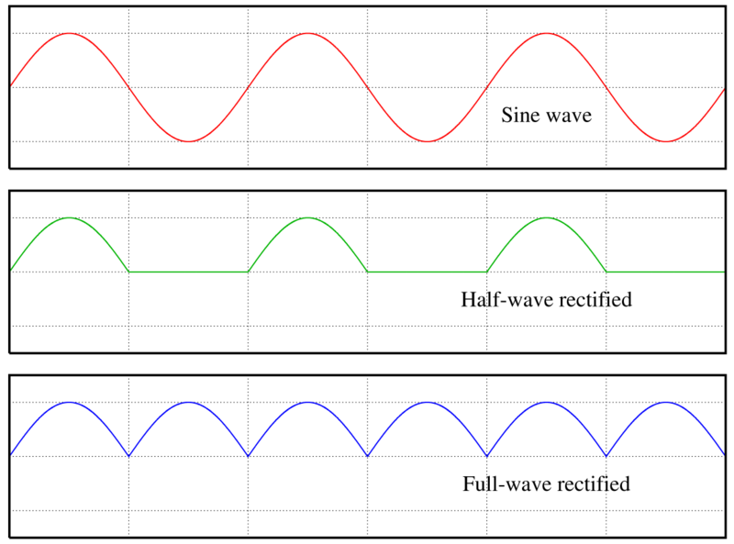
Rectification
Now we come to the most popular application of the diode: rectification.
Simply defined, rectification is the conversion of alternating current (AC) to direct current (DC).
This involves a device that only allows one-way flow of electric charge. As we have seen, this is exactly what a semiconductor diode does.
There are two processes which are used for rectification.
Half-wave rectification
Full-wave rectification
Prepared by Ipshita Tasnim Raha

Slide 21
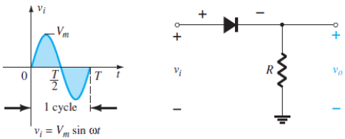
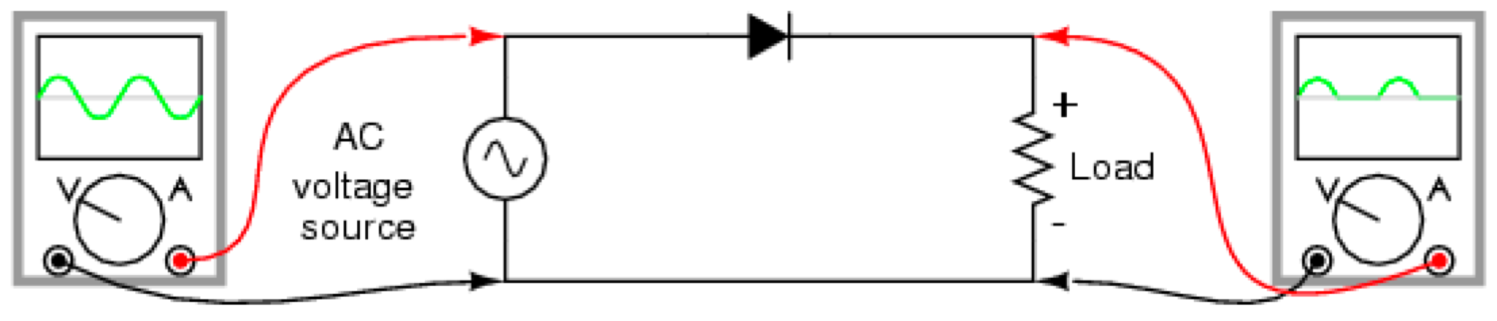
Half Wave Rectifier
In half-wave rectification, the rectifier conducts current only during the positive half-cycles of input A.C. supply. The negative half-cycles of A.C. supply are suppressed that is, during negative half-cycles, no current is conducted and hence no voltage appears across the load.
Therefore, current always flows in one direction (D.C.) through the load though after every half cycle. The circuit of half wave rectifier is given below,
Prepared by Ipshita Tasnim Raha

Slide 22
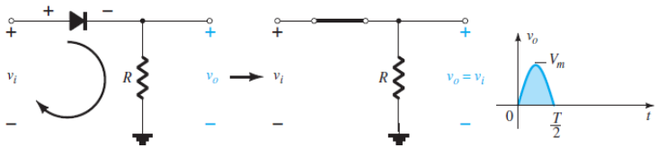
Half Wave Rectifier (+ve half cycle)
During the interval t = 0 → T/2, the polarity of the applied voltage vi is in such direction which turn “on” the diode. Substituting the short-circuit equivalence for the ideal diode will result in the equivalent circuit of the figure given below,
where it is fairly obvious that the output signal is an exact replica of the applied signal. The two terminals defining the output voltage are connected directly to the applied signal via the short-circuit equivalence of the diode.
Prepared by Ipshita Tasnim Raha

Slide 23
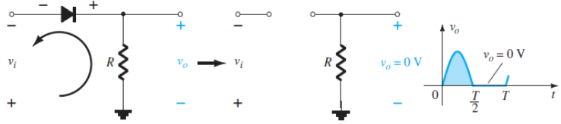
Half Wave Rectifier (-ve half cycle)
For the period t = T/2 → T, the polarity of the input is vi and the resulting polarity across the ideal diode produces an “off” state with an open-circuit equivalent. The result is the absence of a path for charge to flow, and vo = iR = (0)R = 0 V for the period T/2 → T.
Prepared by Ipshita Tasnim Raha

Slide 24
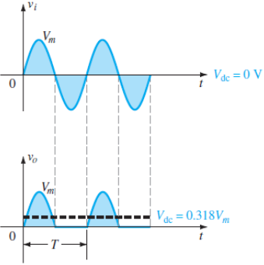

Half Wave Rectifier
The input vi and the output vo are sketched together in the figure, for comparison purposes.
The output signal vo now has a net positive area above the axis over a full period and an average value determined by,
The process of removing one-half the input signal to establish a DC level is called half wave rectification.
Prepared by Ipshita Tasnim Raha

Slide 25
Disadvantages: Half Wave Rectifier
The main disadvantages of a half-wave rectifier are given below:
They only allow a half-cycle through per sinewave, and the other half-cycle is wasted. This leads to power loss.
They produces a low output voltage.
The output current we obtain is not purely DC, and it still contains a lot of ripple (i.e. it has a high ripple factor)
Prepared by Ipshita Tasnim Raha

Slide 26
Full Wave Rectifier:
In full-wave rectification, current flows through the load in the same direction for both half-cycles of input A.C. voltage.
This can be achieved with two diodes working alternately. For the positive half cycle of input voltage, one diode supplies current to the load and for the negative half-cycle, the other diode does so. Current being always in the same direction through the load.
Therefore, a full-wave rectifier utilizes both half-cycles of input A.C. voltage to produce the D.C. output.
The following two circuits are commonly used for full-wave rectification:
Bridge Network
Center Tapped Transformer
Prepared by Ipshita Tasnim Raha

Slide 27
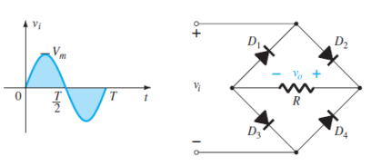
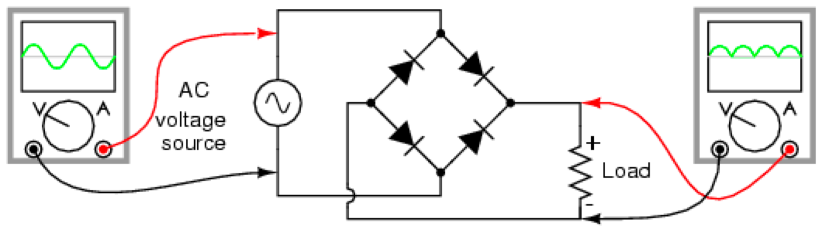
Full Wave Rectifier: Bridge Network
The dc level obtained from a sinusoidal input can be improved 100% using a process called full-wave rectification. The most familiar network for performing such a function appears in the figure with its four diodes in a bridge configuration.
Prepared by Ipshita Tasnim Raha

Slide 28
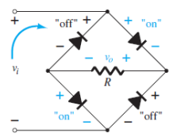
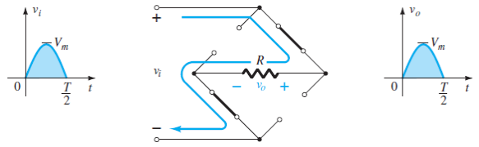
Bridge Network: (+ve half cycle)
During the period t = 0 to T/2 the polarity of the input is as shown in the below figure. The resulting polarities across the ideal diodes are also shown in the figure to reveal that D2 and D3 are conducting, whereas D1 and D4 are in the “off” state.
The net result is the configuration of the below figure, with its indicated current and polarity across R. Since the diodes are ideal, the load voltage is vo = vi, as shown in the figure.
Prepared by Ipshita Tasnim Raha

Slide 29
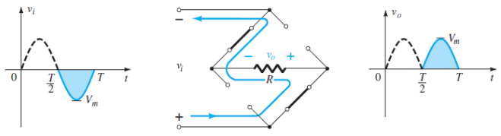
Bridge Network: (-ve half cycle)
For the negative region of the input the conducting diodes are D1 and D4, resulting in the configuration of the below figure,
Prepared by Ipshita Tasnim Raha

Slide 30

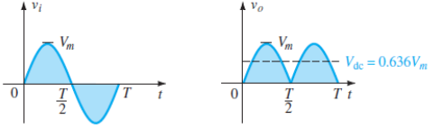
Bridge Network
Since the area above the axis for one full cycle is now twice that obtained for a half-wave system, the DC level has also been doubled and average value
Prepared by Ipshita Tasnim Raha

Slide 31
Bridge Network: Advantage & Disadvantage
Advantages:
The need for centre-tapped transformer is eliminated.
The output is twice that of the centre-tap circuit for the same secondary voltage.
The PIV is one-half that of the centre-tap circuit (for same D.C. output).
Disadvantages:
It requires four diodes.
Prepared by Ipshita Tasnim Raha

Slide 32
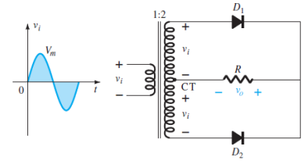
Center Tapped Transformer:
A second popular full-wave rectifier with only two diodes but requiring a center-tapped transformer to establish the input signal across each section of the secondary of the transformer. The circuit diagram of center tapped transformer is given below,
Prepared by Ipshita Tasnim Raha

Slide 33
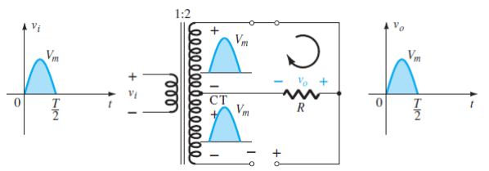
Center Tapped Transformer: (+ve half cycle)
During the positive portion of vi applied to the primary of the transformer, the network will appear as shown in the figure bellow. With a positive pulse across each section of the secondary coil D1 assumes the short-circuit equivalent and D2 the open-circuit equivalent, as determined by the secondary voltages and the resulting current directions. The output voltage appears as shown in the figure.
Prepared by Ipshita Tasnim Raha

Slide 34
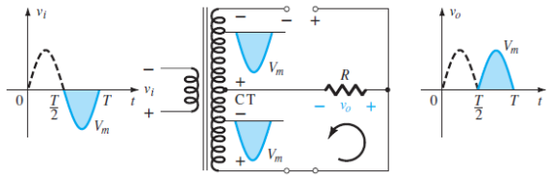
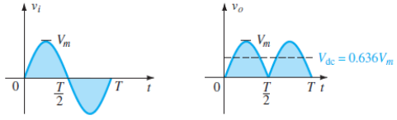
Center Tapped Transformer: (-ve half cycle)
During the negative portion of the input the network reverse the roles of the diodes but maintains the same polarity for the voltage across the load resistor R. The net effect is the same output with the same dc levels.
Overall one full cycle the input and output voltages will be,
Prepared by Ipshita Tasnim Raha

Slide 35
Center Tapped Transformer: Disadvantages
Disadvantages:
It is difficult to locate the centre tap on the secondary winding.
The D.C. output is small as each diode utilizes only one-half of the transformer secondary voltage.
The diodes used must have high peak inverse voltage.
Prepared by Ipshita Tasnim Raha

Slide 36
Peak Inverse Voltage (PIV):
Peak inverse voltage (PIV) or peak reverse voltage (PRV) rating of the diode is the voltage rating that must not be exceeded in the reverse bias region so that the diode will not enter in the zener breakdown region.
PIV for Half wave rectifier circuit ≥ Vm
PIV for Full wave Bridge rectifier circuit ≥ Vm
PIV for Center-tapped Full wave rectifier circuit ≥ 2Vm
Prepared by Ipshita Tasnim Raha

Slide 37

Quiz Time!
A brief assessment
Don’t Worry!
A quiz is a form of game or mind sport.
Prepared by Ipshita Tasnim Raha

Slide 38
Zener diodes can be effectively used in voltage regulator. However, they are these days being replaced by more efficient
Operational Amplifier b) MOSFET c) Integrated Circuits
2. What is the level of doping in Zener Diode?
Lightly Doped b) Heavily Doped c) Moderately Doped d) No doping
3. 4. Zener Diode is mostly used as ____________ a) Half-wave rectifier b) Full-wave rectifier c) Voltage Regulator d) LED
4. The depletion region of the Zener diode is ____________ a) Thick b) Normal c) Very Thin d) Very thick
5. When the reverse voltage across the Zener diode is increased _____________ a) The value of saturation current increases b) No effect c) The value of cut-off potential increases d) The value of cut-off potential decreases

Slide 39
C
B
C
C
C

Slide 40
Success comes from
Curiosity, Concentration,
Perseverance and self criticism
- Albert Einstein
Prepared by Ipshita Tasnim Raha

Slide 41
Thanks!
Any questions?

